Slide 1
Unit 3 – Project
Exam Preparation

Slide 2
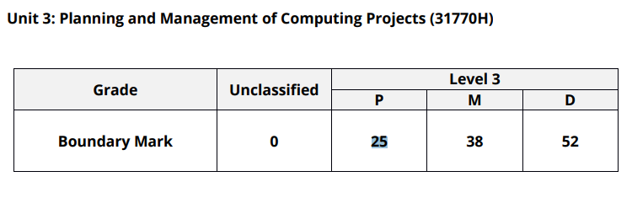
Pass/Merit/Distinction
Below are the marks that you need to Pass, Merit or Distinction

Slide 3
What does the exam consist of?
Part A:
Activity 1: Project Initiation Document (PID)
Activity 2: Project Planning Documents
Part B:
Activity 3: Project Checkpoint Report
Activity 4: Project Closure Email

Slide 4
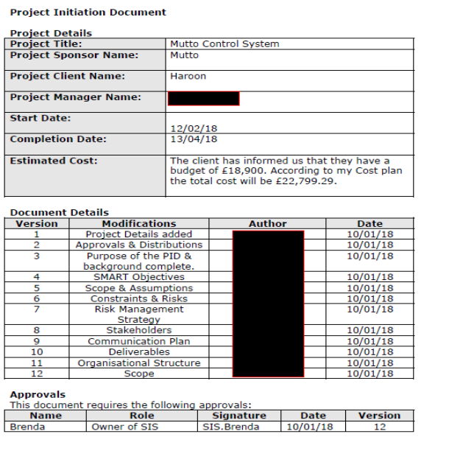
Activity 1: Project Initiation Document (PID)
Project start and end dates should be given on the exam paper. The names of everyone involved should be given in the form of some form of structure chart/role and responsibilities.
You need to cherry pick the information and add it to the start of the PID document.
Where the document has been “redacted” (blanked out the author) that’s where YOUR names goes.
The “Document Details” is where you list each elements of the PID document, you do this with who the author is of this section (YOU). You do this so later you can potentially modify individual sections.
Lastly, approvals in the individual who wants the project.

Slide 5
Activity 1: Project Initiation Document (PID)
Distributions
Purpose of the Project Initiation Document
Project Aims
Project Management and Control
Background to the propose work

Slide 6
Activity 1: Project Initiation Document (PID)
Purpose of the project
Responsibilities
Materials

Slide 7
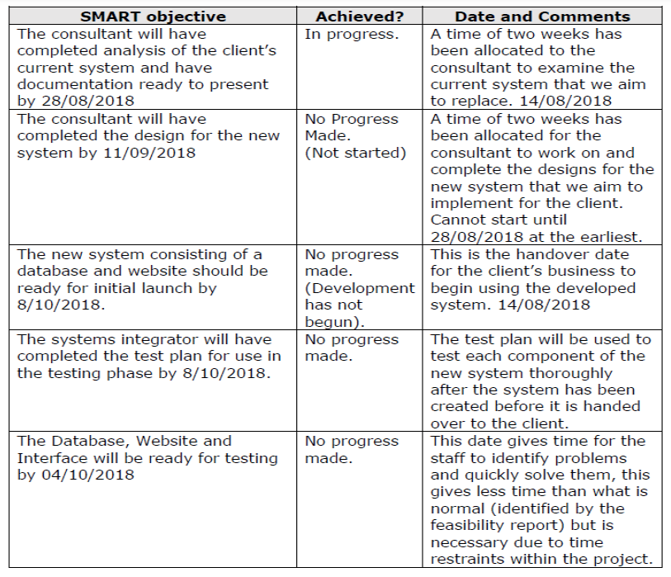
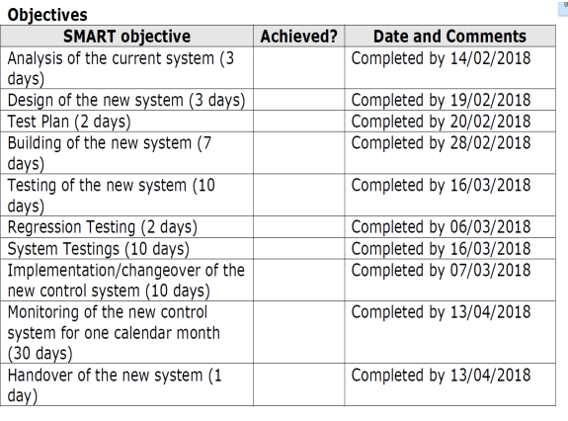
Activity 1: Project Initiation Document (PID)
Objectives
Example 2:
Example 1:

Slide 8
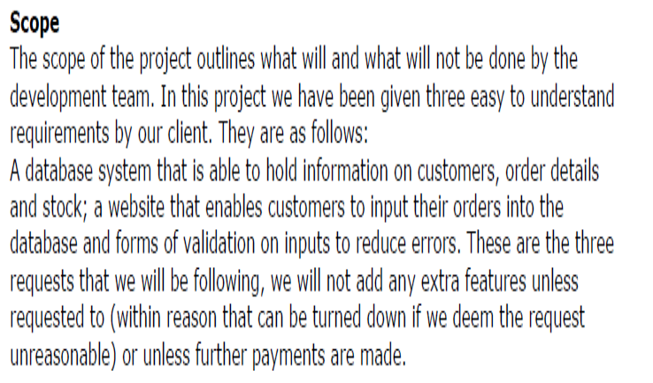
Activity 1: Project Initiation Document (PID)
The project scope should define the work to be performed to deliver the product, with specified features and functions; this can include tools and techniques and sometimes the characteristics of the product. The scope should define the agreed limits of a project, for example, the project may agree to provide the Server and user database but might not provide ongoing support and maintenance. These facts should be defined in the scope section. The example has met this well by focusing on the product features and functions and providing some limitations.
Scope

Slide 9
Activity 1: Project Initiation Document (PID)
Business Case

Slide 10
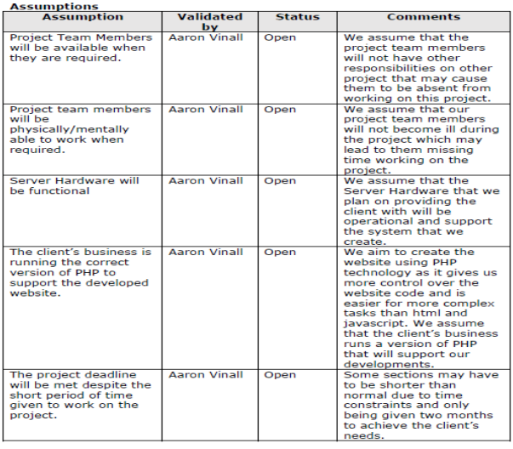
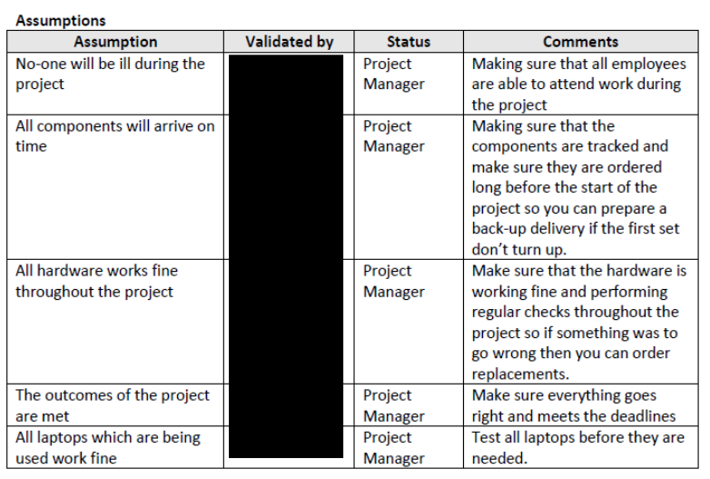
Activity 1: Project Initiation Document (PID)
Assumptions
Example 2:
Example 1:
Notes:
What is “assumed during the project”?

Slide 11
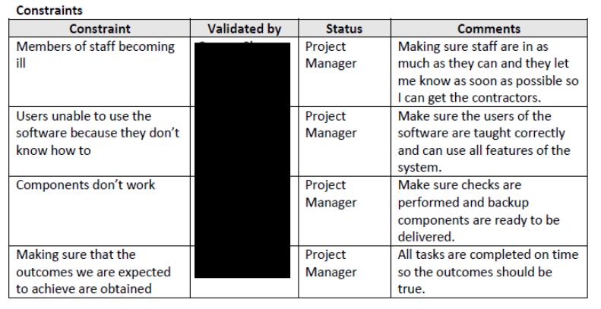
Activity 1: Project Initiation Document (PID)
Constraints

Slide 12
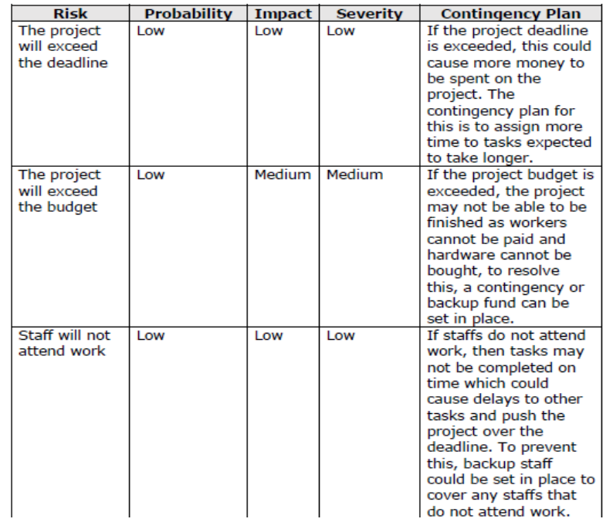
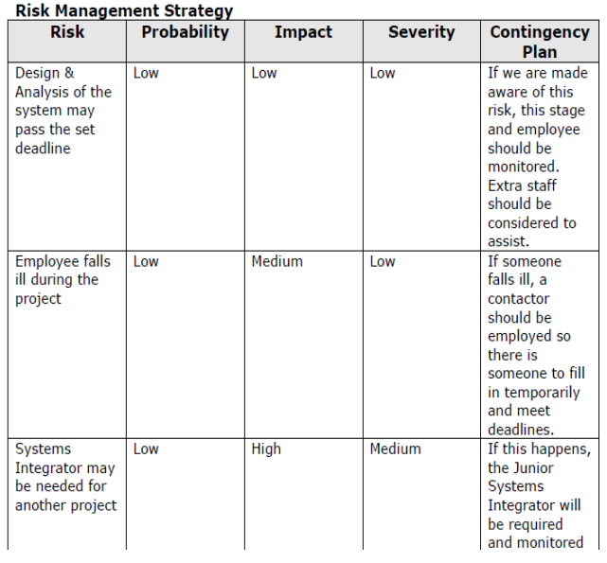
Activity 1: Project Initiation Document (PID)
Risk Management Strategy
Example 2:
Example 1:

Slide 13
Activity 1: Project Initiation Document (PID)
Deliverables

Slide 14
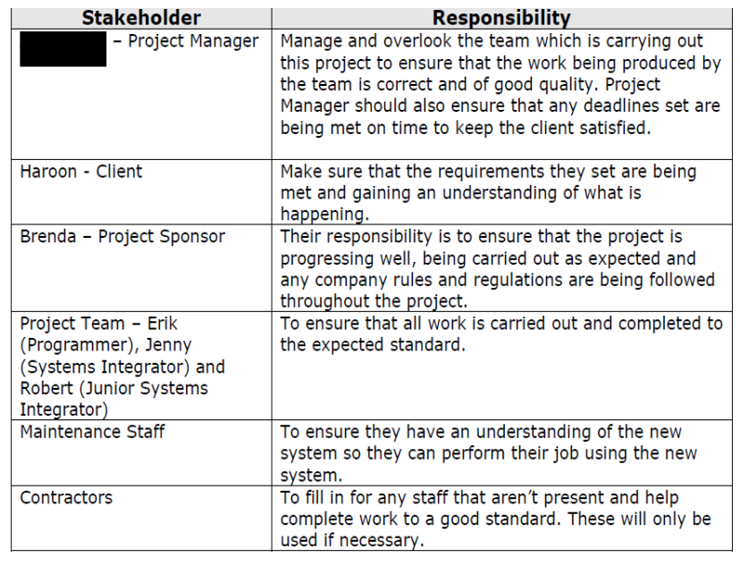
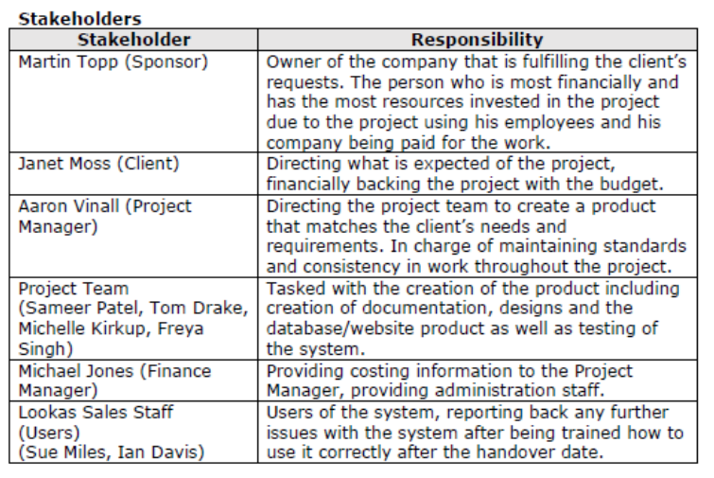
Activity 1: Project Initiation Document (PID)
Stakeholders
Example 1:
Example 2:
Notes:
Must include everyone that in involved in the project

Slide 15
Activity 1: Project Initiation Document (PID)
Project Management Team Structure/Organisation chart

Slide 16
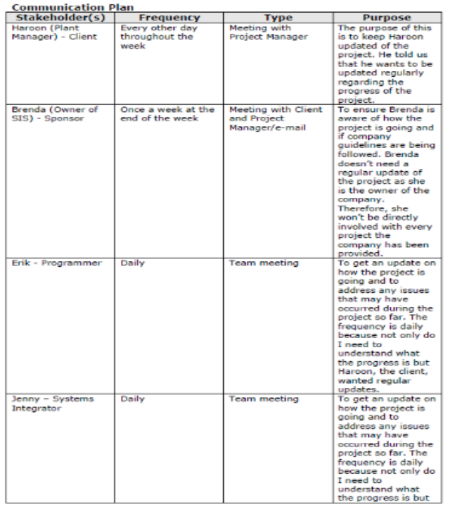
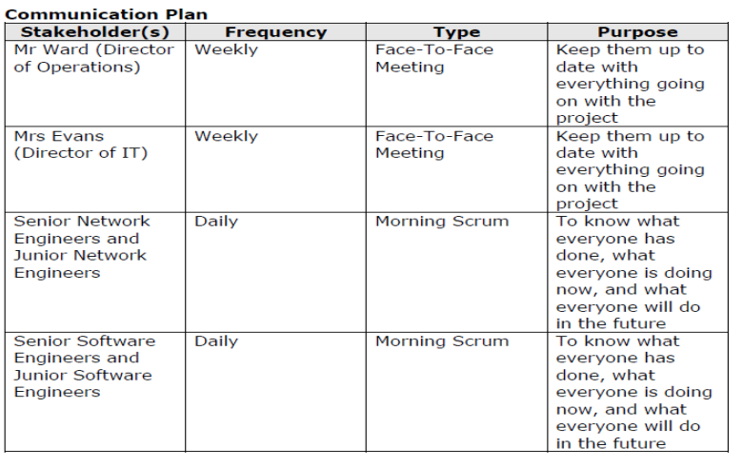
Activity 1: Project Initiation Document (PID)
Communication Plan
Example 2:
Example 1:
Notes:
The frequency and type of communication are appropriate for the target audience, using logical chains of reasoning that show awareness of the given scenario. More emphasis and weight for the top end marks are for the purpose. The example 2 demonstrates that you have thought about why communication is necessary thinking about what to discuss during the communication.

Slide 17
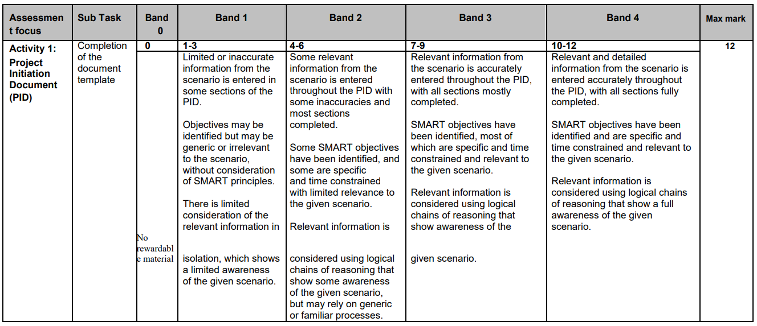
Mark Scheme for PID

Slide 18
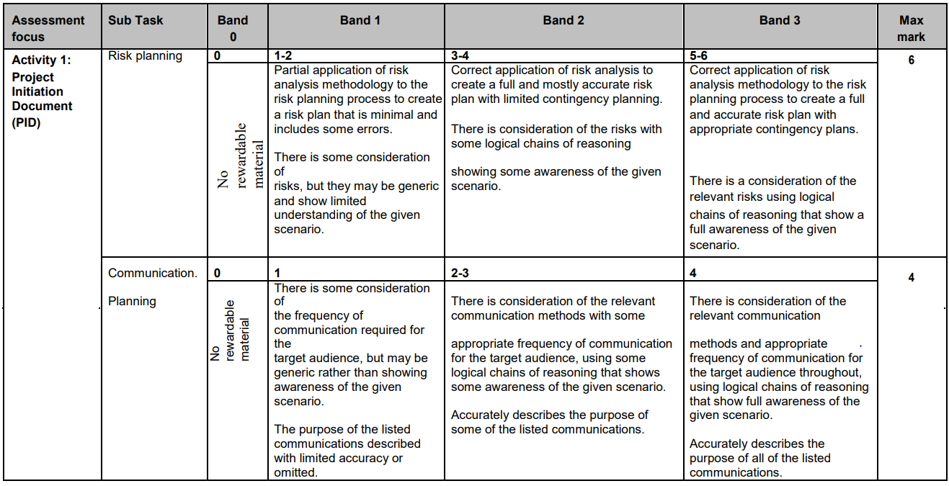
Mark Scheme for PID – Risk/Communication

Slide 19
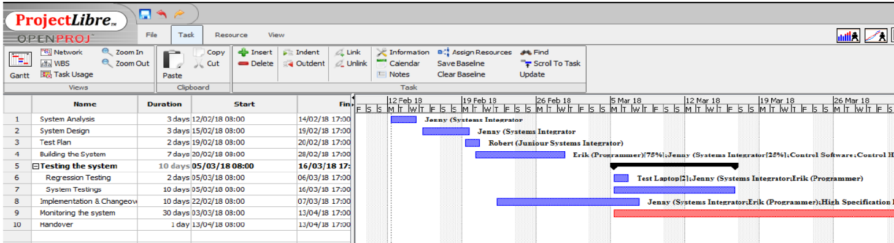
Activity 2: Project Planning Documents
Ghantt Chart Example 1
Notes:
Gantt chart with list of tasks which follow the project life cycle, in order for the scenario and shows final task and changeover. Clear dates with time constrained demonstrated. They have added milestones and resources to each task, in this case the allocation of task to the correct worker.

Slide 20
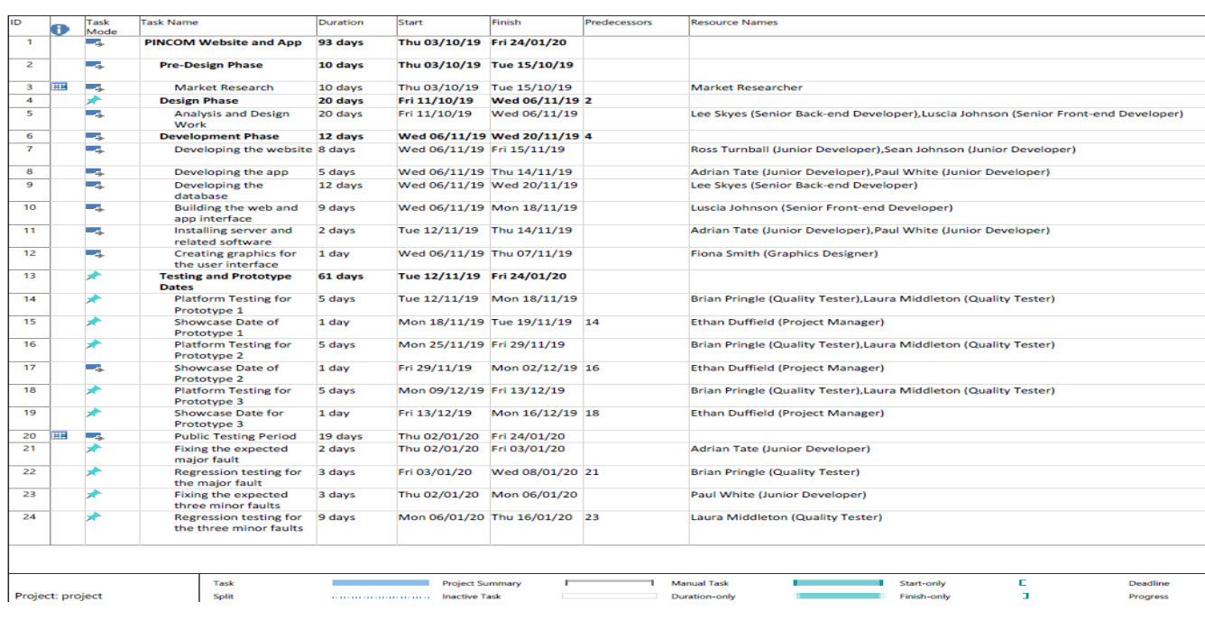
Activity 2: Project Planning Documents
Ghantt Chart Example 2
Notes:
Every task that needs to be one is listed and allocated a specific time to be completed by.

Slide 21
How to create a Gantt chart
Here is a tutorial on how to create a Gantt chart:
https://www.youtube.com/watch?v=tIqb3ii9nOs
You can practice on the following websites AT HOME:
o www.projectlibre.org/
o www.smartsheet.com
o www.abstractspoon.com

Slide 22
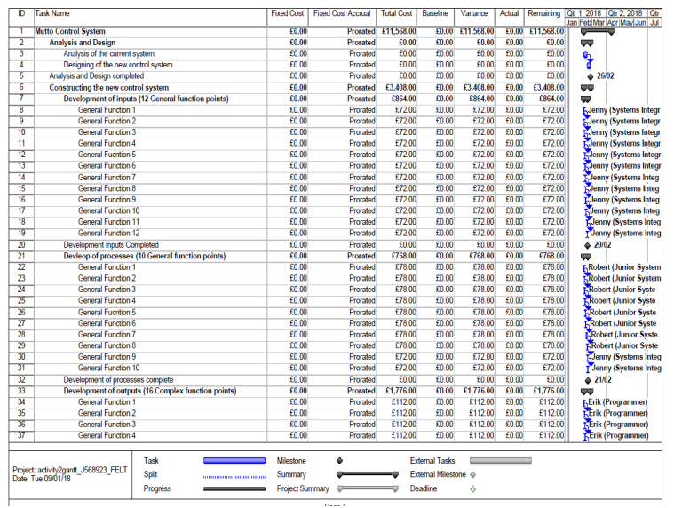
Activity 2: Project Planning Documents
Cash Flow Example 1
Included hardware resources and cost, the time needed for each employee with cost, evidence of how you attained the number of days required.
It has come under budget.

Slide 23
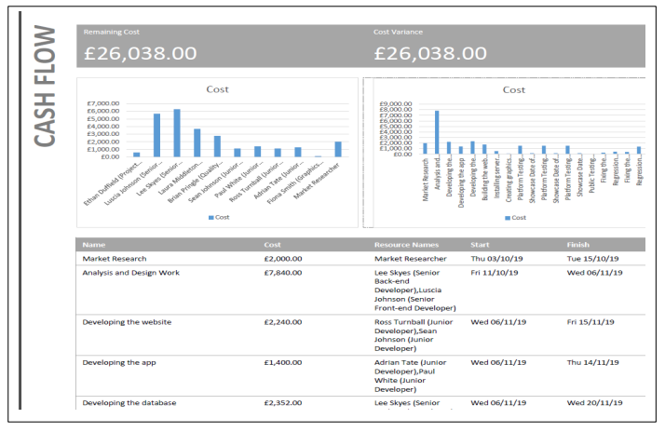
Activity 2: Project Planning Documents
Cash Flow Example 2
Included hardware resources and cost, the time needed for each employee with cost, evidence of how you attained the number of days required.
It has come under budget.

Slide 24
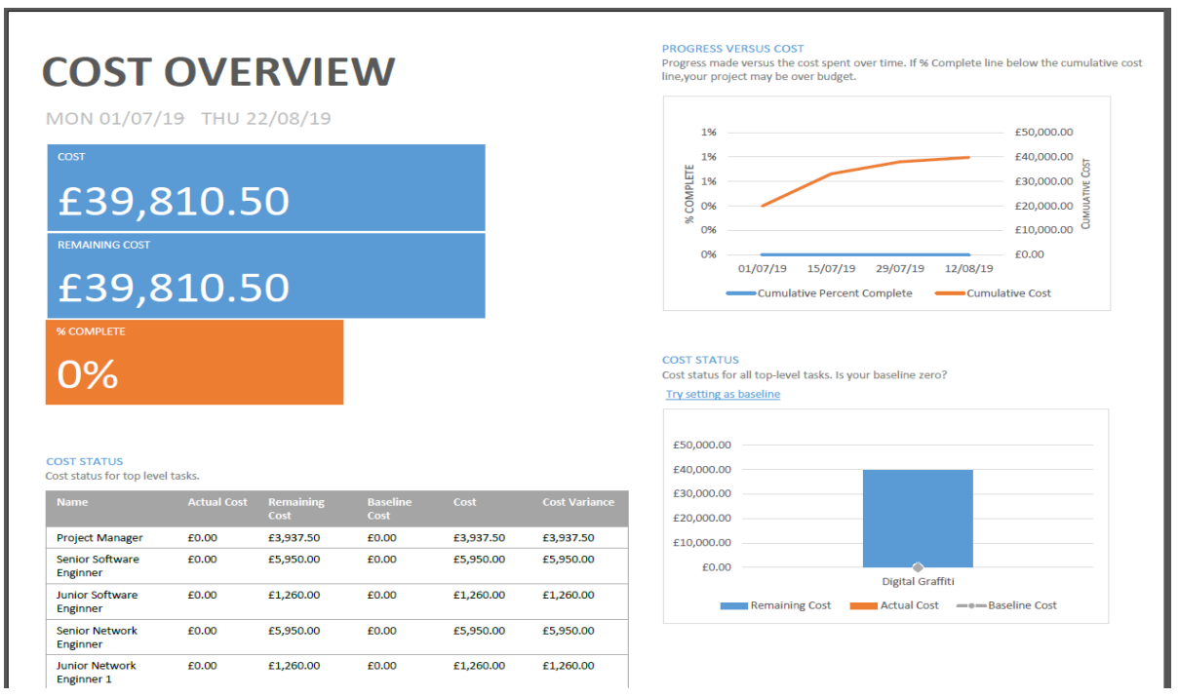
Activity 2: Project Planning Documents
Cash Flow Example 3

Slide 25
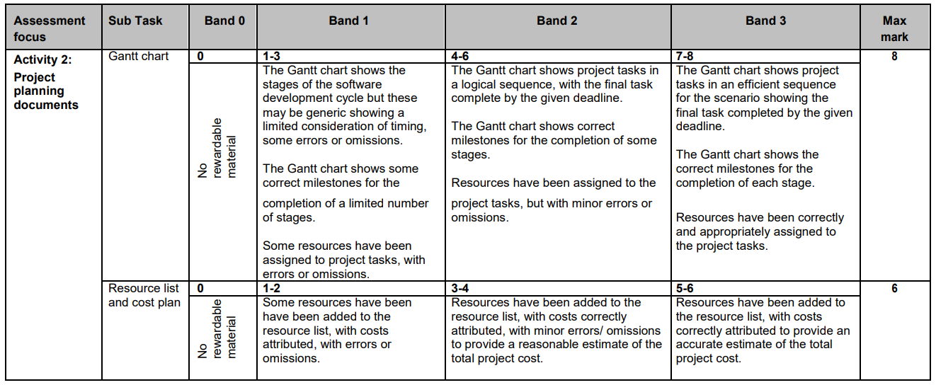
Mark Scheme

Slide 26
PART B
Exam Preparation

Slide 27
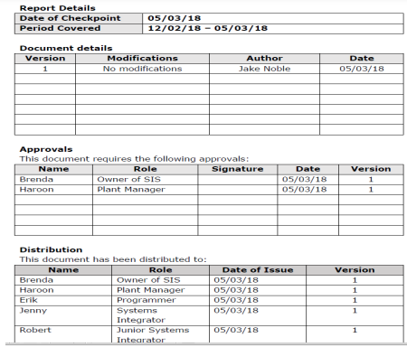
Activity 3: Project Checkpoint Report
Who is approving?
Distribution: Everyone

Slide 28
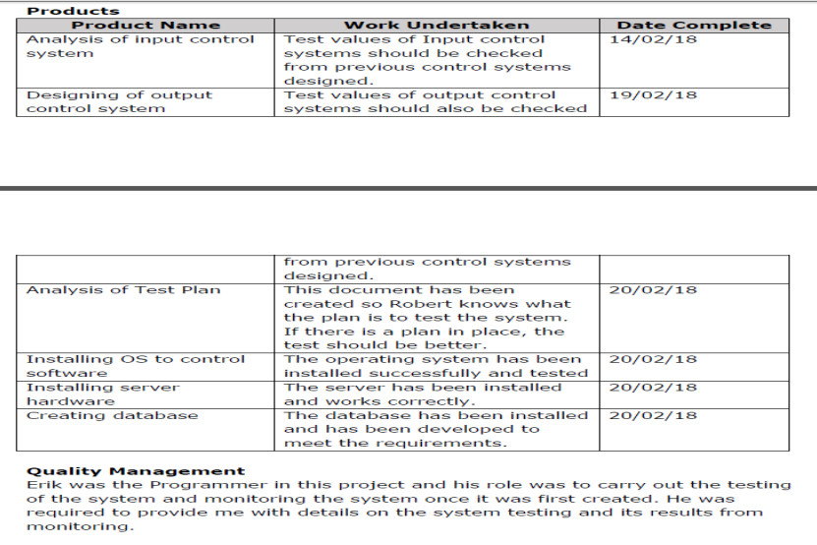
Activity 3: Project Checkpoint Report
Products

Slide 29
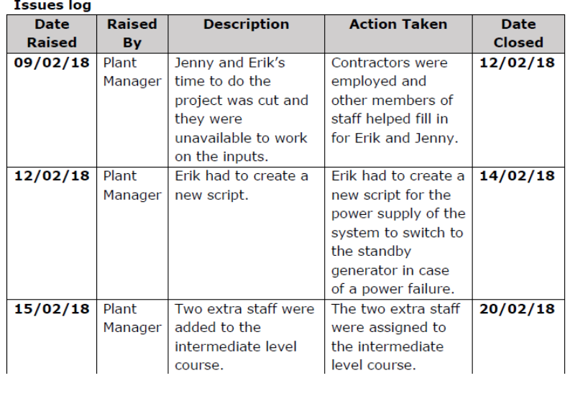
Activity 3: Project Checkpoint Report
Issue Log

Slide 30
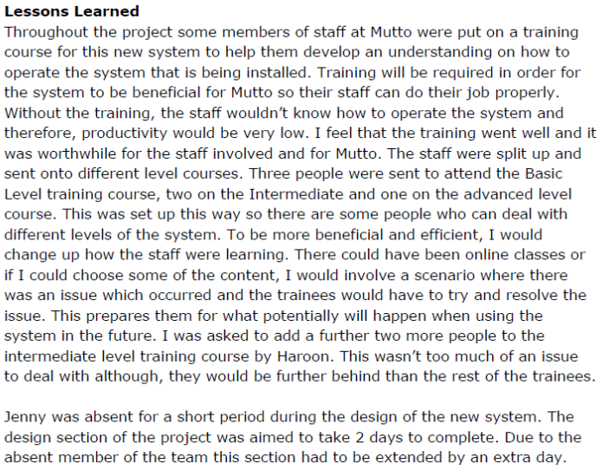
Activity 3: Project Checkpoint Report
Lessons Learned

Slide 31
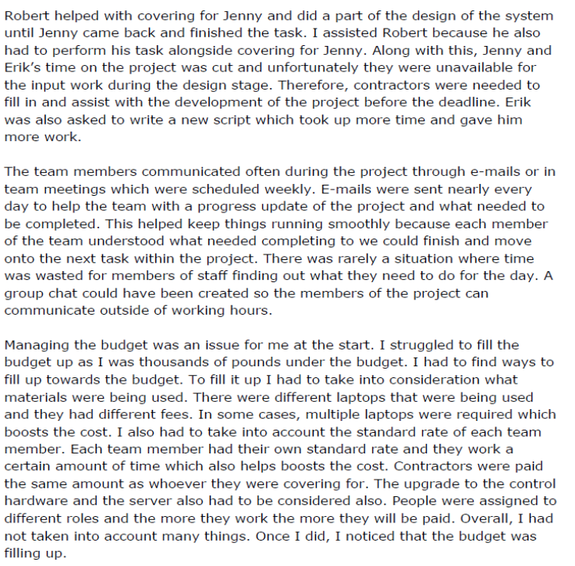
Activity 3: Project Checkpoint Report
Lessons Learned Part 2
This section should evaluate progress and performance, should inform what changes they would make to future working practices. Discussing communication issues with the team. Areas discussed at the stage, any issues dealt with, any cost saving or additional costs, the impact, timings and the scope of the task, which is set out at the beginning.

Slide 32
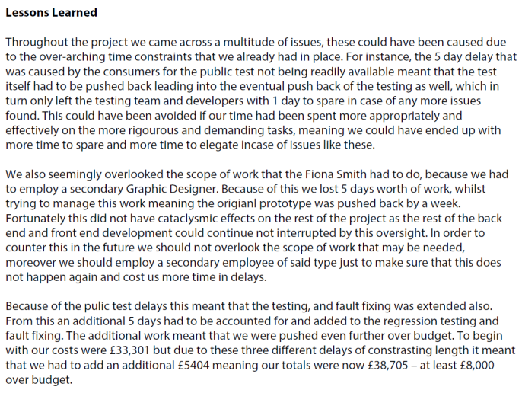
Activity 3: Project Checkpoint Report
Lessons Learned Example 2:
Evaluate progress and performance and should inform what changes they would make to future working practices.
Areas that can be discussed at this stage are any issues dealt with, any cost saving or additional costs, the impact, timings and the scope of the task. Considered the future, what you can transfer to future projects.

Slide 33
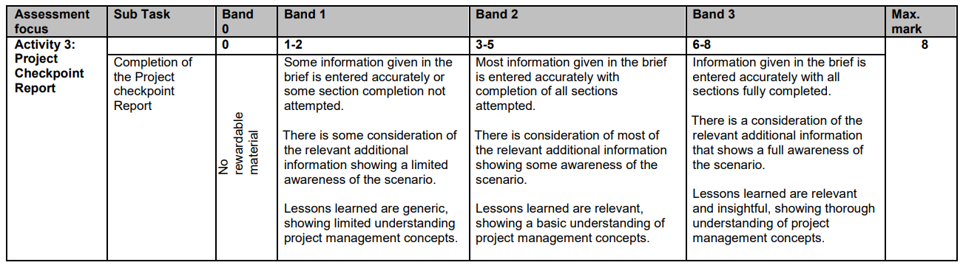
Mark Scheme

Slide 34
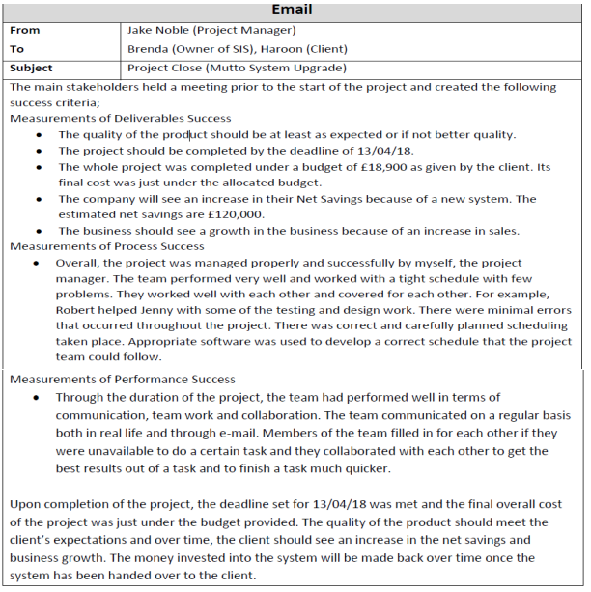
Activity 4: Project Closure Email
Project Closure Email
There are three main areas, Success criteria is “There is an accurate summary of how quality criteria were met showing an awareness of the scenario throughout”. The second part is review of the project, linking this to the project lifecycle. The third part is summary of lesson learnt. For the success criteria we are expecting you to look at part A of the exam and review if they have met their objectives, and if so how and if not why not,

Slide 35
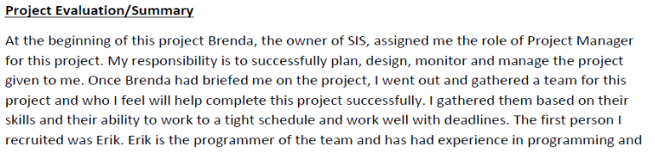
Activity 4: Project Closure Email
Project Evaluation

Slide 36
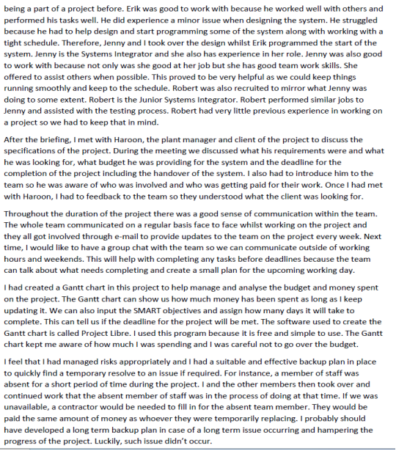
Activity 4: Project Closure Email
Project Evaluation
For the review of the project, after the project has closed, there is opportunity to determine project success you are expected to give a relevant and well-balanced review. Discussing the various stages of the project lifecycle or elements.

Slide 37
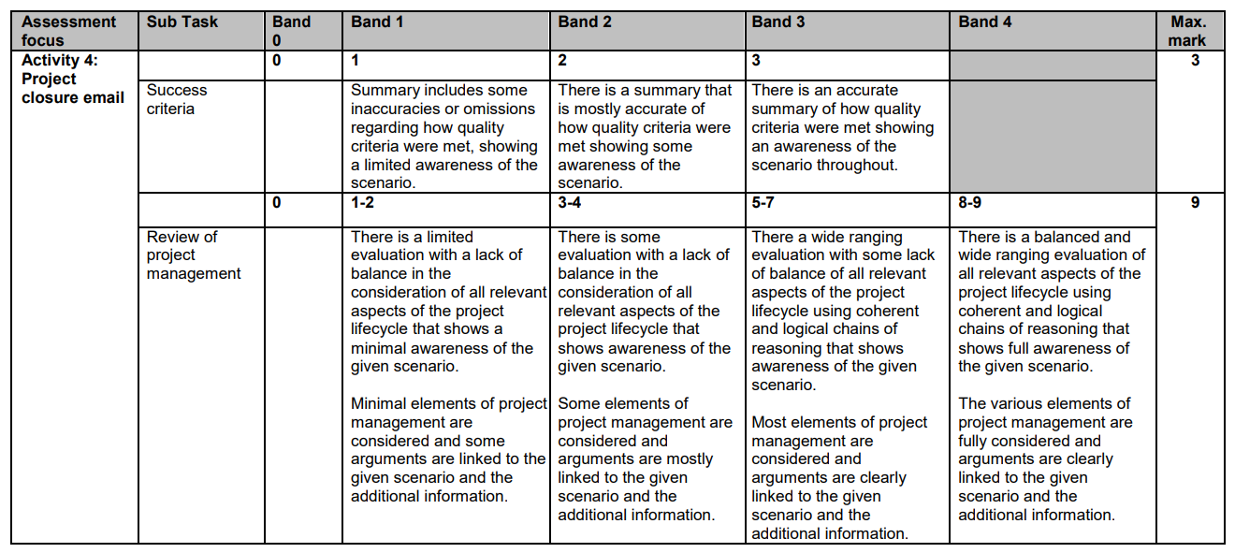
Mark Scheme

Slide 38
Mark Scheme

Slide 39
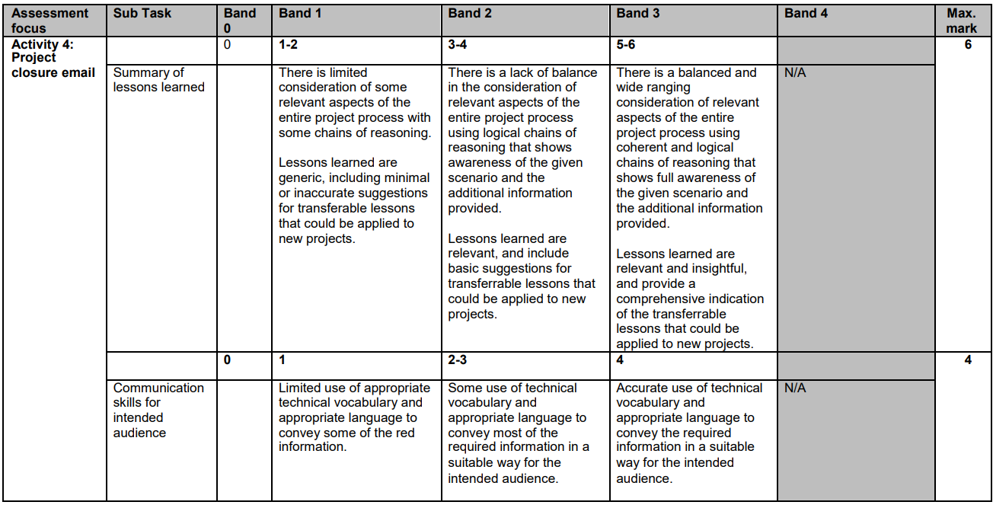
Mark Scheme

